Slide 1

2014
Acton-Boxborough
MCAS Highlights
Presented by
Bill Guthlein & Amanda Bailey
November 20, 2014

Slide 2
MCAS Highlights for A-B
Special Education Students
The proficiency gap is flat or widening for special education students at APS & R. J. Grey, not closing per state MCAS targets for 2017.
The state requires a minimum Student Growth Percentile (SGP) of 51 to receive a passing grade in the accountability formula and recommends an SGP range of 51-59 to meet 2017 goals.*
4th grade ELA student growth for special education students has been at or below the state average for the last four years.
7th grade ELA student growth for special education students has been at or below the state average for three years in a row.
* Note that a 51 SGP may not necessarily close the proficiency gap for any group
during a particular time period.

Slide 3
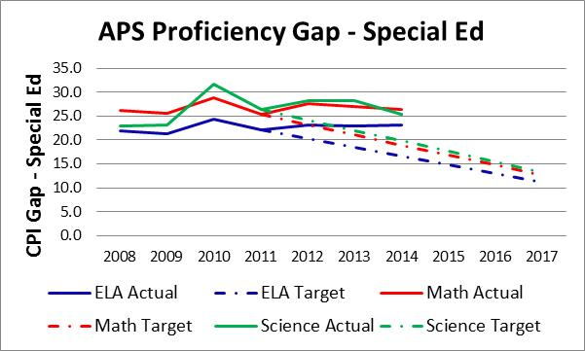
APS Proficiency gap closure
Not on target for 2017

Slide 4
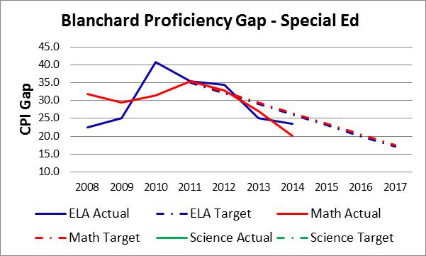
Blanchard Proficiency Gap closure on Target for 2017

Slide 5
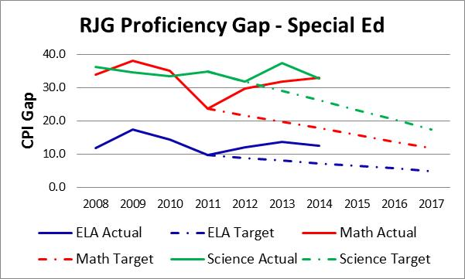
R. J. Grey Proficiency gap closure Not on target for 2017

Slide 6
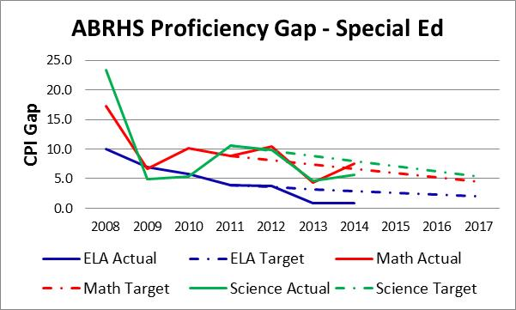
ABRHS Proficiency gap closure
On target for 2017 except for math

Slide 7
4th grade ela student growth
APS 4th grade special education ELA student growth has been at or below the state average for the last four years.
In 2014, this cohort represents 74 students with disabilities, which is 20% of the aggregate population.

Slide 8
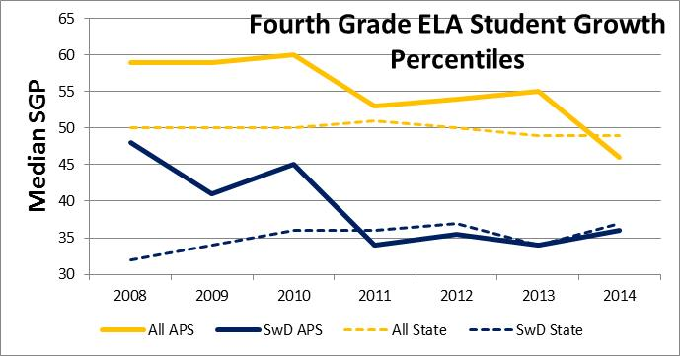
4th grade ELA student growth –
APS vs. state average

Slide 9
7th grade ELA Student growth
AB 7th grade special education ELA student growth has been well below the state average and peer communities for the last three years.
In 2014, this cohort represents 77 students with disabilities, which is 16% of the aggregate population.

Slide 10
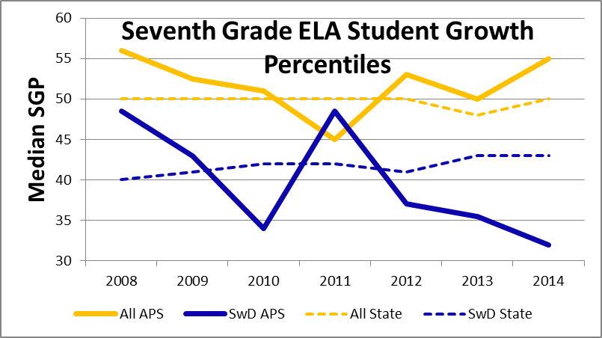
7th grade ela student growth –
R. J. Grey vs. state average

Slide 11
District interventions to improve student performance
Over the last 3-4 years, the district has implemented many good curriculum changes, identified reading comprehension and writing as areas of focus for staff development, and added important personnel (e.g., dedicated Math and ELA curriculum specialists) to improve student outcomes across the district. The aggregate student population has responded well to these interventions and student gains are reflected in annual MCAS performance – see R. J. Grey’s strong aggregate growth.
Unfortunately, with the exception of 2011when targeted interventions (co-taught Math, special education staff training, increased services) were implemented to support students with special needs at R. J. Grey, the special education subgroup of students does not appear to have benefited significantly from the changes adopted across the district.

Slide 12
Questions
Have we done targeted MCAS analysis of special education students to identify individual and collective group needs/areas of academic difficulty? Do we understand what is driving our low 4th and 7th grade special education student performance?
Are we structured to support High Needs students effectively in this district?
Are we staffed adequately to support the dramatically increasing number of special education and other High Needs students?
Are we staffed appropriately to allow for successful implementation of research-based best practices in special education (e.g., push-in service delivery, professional collaboration/shared planning time, co-taught curriculum)?
Do we provide adequate special education related professional development to all staff working with this student population?

Slide 13
Desired OUtcomes
We’d like the district to fully commit to closing the proficiency gap 50% by 2017 for special education students in keeping with state targets.
We’d like the district to establish a concrete, targeted plan to improve special education student performance particularly at the 4th and 7th grade levels this year.
We’d like to request that the district share its formative assessment results with parents throughout the year and in summary form with the AB SpEd PAC and School Committee to provide additional data points regarding student growth and achievement within the district.

Slide 14
Addendum
We’ve included four slides that give additional detail about proficiency gap assessment for Blanchard, APS, R. J. Grey, and ABRHS. *
* Please note in multiple instances we “Met Goal” based on exemptions, not on actual
performance improvement for this population of students.

Slide 15
Proficiency gap Data at blanchard

Slide 16
Proficiency gap data for aps

Slide 17
Proficiency gap data for r. j. grey

Slide 18
Proficiency gap data for abrhs

